Slide 1


Impact of Anomaly Detection on Hydrogen Fuel Cells
with Machine Learning
Dillon Wood
B.S. Electrical Engineering
Arkansas Tech
University
Russellville, AR, USA
dwood16@atu.edu
Benjamin Leon
B.S. Electrical Engineering – Biomedical
Arkansas Tech
University
Russellville, AR, USA
bleon1@atu.edu
Ethan Mashburn
B.S. Electrical Engineering
Arkansas Tech
University
Russellville, AR, USA
emashburn@atu.edu
Mentors
Dr. Afsana Ahamed Department of Electrical Engineering Arkansas Tech Russellville, AR, USA aahmed@atu.edu | Dr. Ehsan Hosseini Department of Mechanical Engineering Arkansas Tech Russellville, AR, USA shosseini@atu.edu

Slide 2
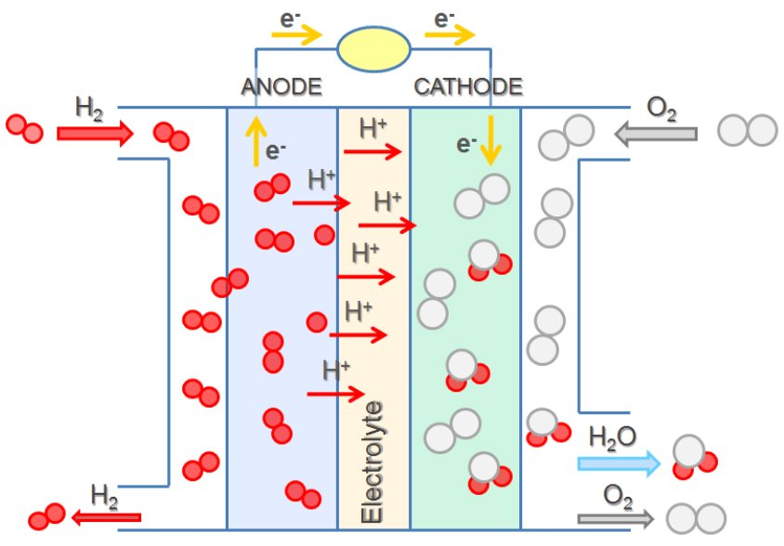
Hydrogen Fuel Cells
Importance of Hydrogen Fuel Cells
Critical technology for sustainable energy solutions and carbon-free projects
Clean, efficient, and renewable energy source
Key technology for electric vehicles, space missions, and grid storage
Performance and safety depend on early detection of failures or degradation
Why The Use of Machine Learning (ML)
Fuel cell data is complex and is time-series based
Traditional threshold-based monitoring may miss subtle failures
ML can learn patterns and detect outliers automatically.

Slide 3
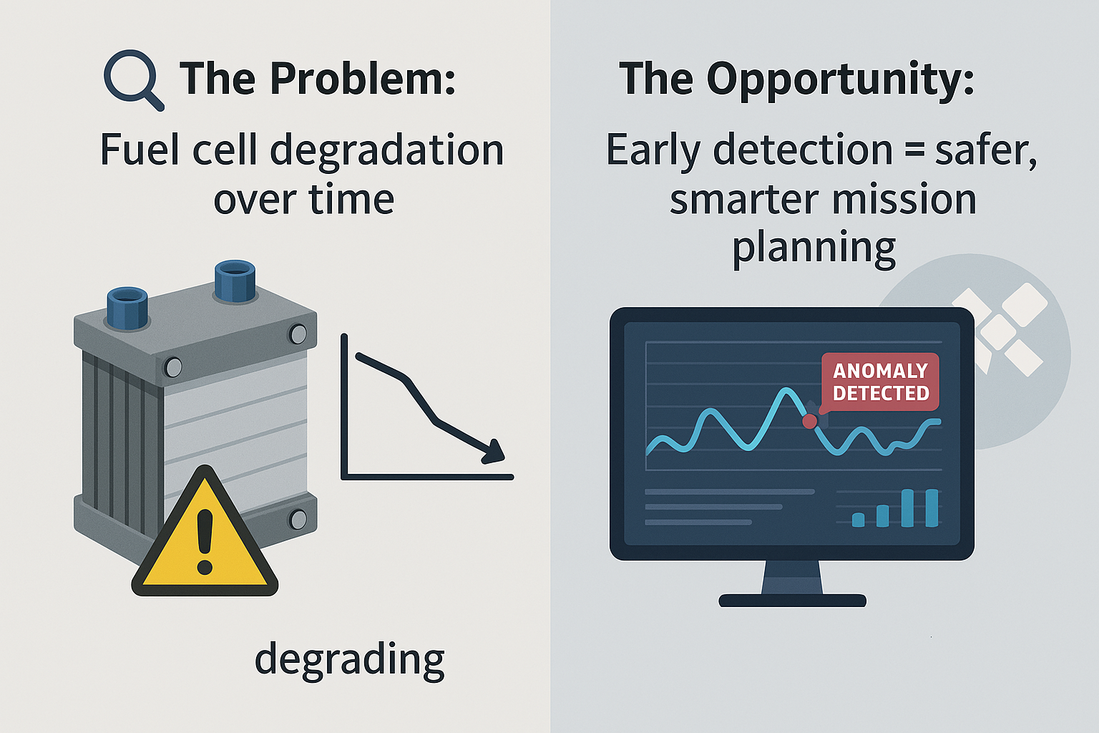
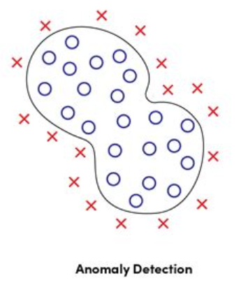
The Problem: Degradation in Hydrogen Fuel Cell Performance
Chemical and thermal stress, Electrode wear and membrane thinning, Contamination or corrosion in components
This degradation often starts with subtle anomalies in voltage, current, or impedance during regular charge/discharge cycles.
The Opportunity: Real-Time Learning Through Anomaly Detection
Optimize Maintenance Schedules (based off battery health)
Refine Future Battery Designs and Usage Protocols
Inform Mission Planning

Slide 4
DATASET The dataset consists of data from 4 Hydrogen Fuel Cell batteries built for Electric Commuter Vehicles in space exploration. The dataset is available to the public as a continuous record of the 4 batteries.
Total Batteries | File Name | Cycle Types | Measurements per Cycle
4 (IDs: 5, 6, 7, 18) | nasaBattery.csv | Charge, Discharge, and Impedance operations | Voltage, Current, Temp, Capacity, Impedance, and Resistance
Data Structure is a top-level structure array. A Total of 185,721 instances distributed over 4 batteries
Charging Measurements Units
Cell Voltage | Cell Current | Temperature | Load Charge | Load Voltage | Date Time
Battery Terminal (V) | Battery Output Current (Amps) | Battery Temperature (C) | Current at Load Device (Amps) | Voltage at Load Device (V) | Time Vector for cycles
The tested dataset was randomly sampled at 20% of the full dataset for efficiency.

Slide 5
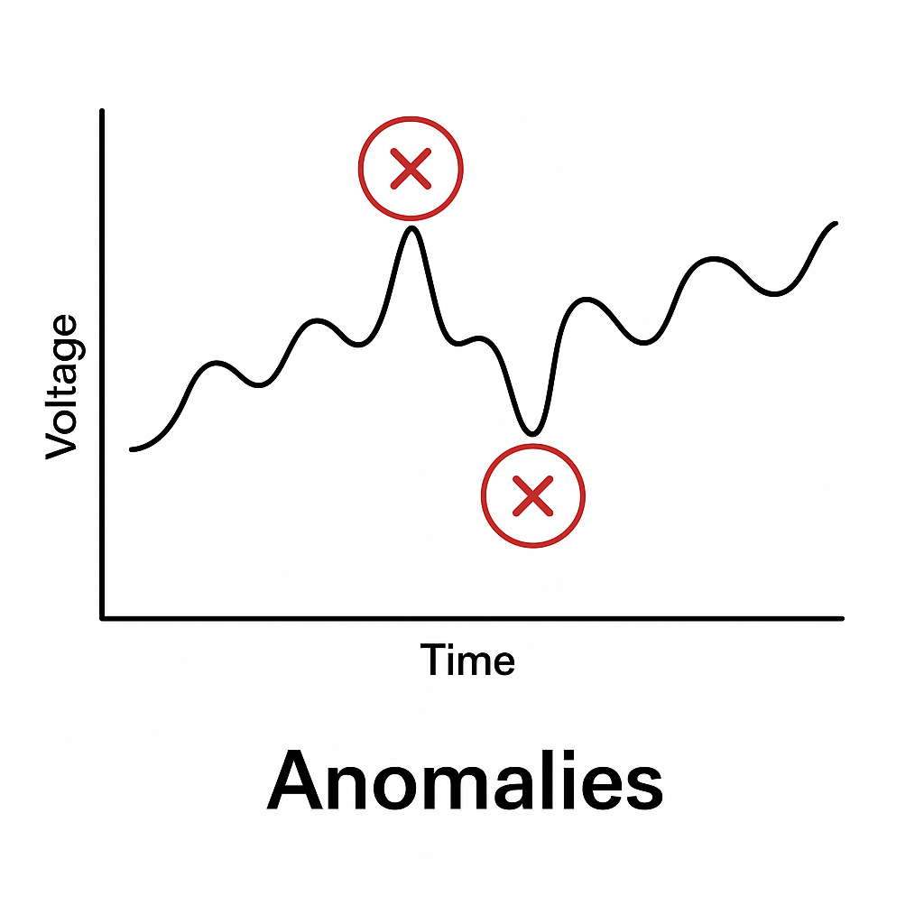
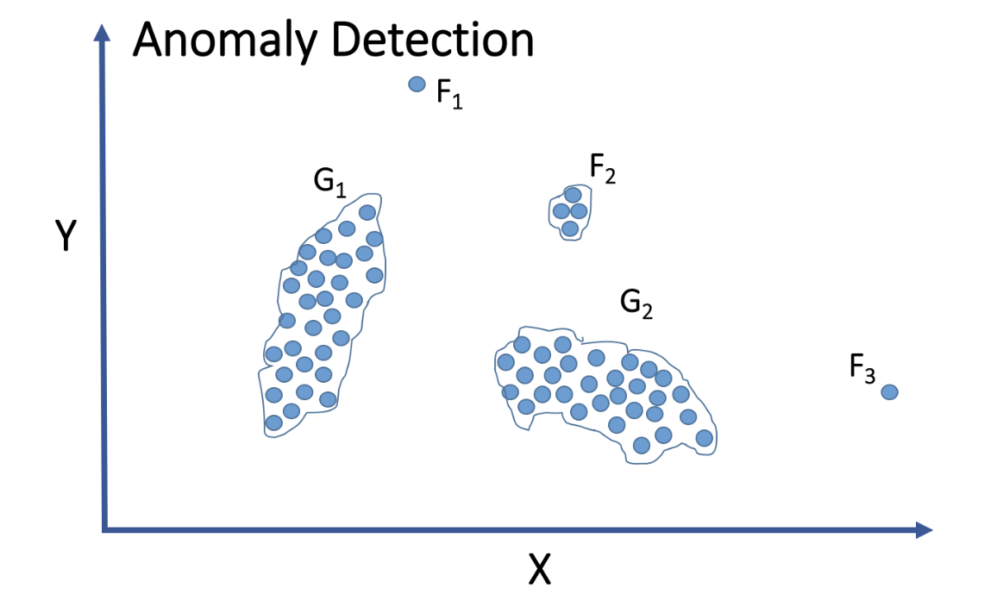
What are Anomalies?
Anomalies are significant deviations from normal values
Caused by errors, rare events, or critical issues

Slide 6
Unsupervised vs Supervised Learning in Anomaly Detection
Unsupervised | Supervised
Used to detect unknown or subtle anomalies in without labeled data. Helpful for evaluating large, complex datasets. Models: Isolation Forest, LOF, One-Class SVM | After detecting anomalies, we compared the model overlaps to find high-confidence labels These labels are used to train a supervised model for higher accuracy and real time monitoring. Models: Logistic Regression, SVM, Decision Tree, Random Forest, KNN
Using different model types detects different kinds of anomalies and comparing results can identify consistent flagged anomalies across models.

Slide 7
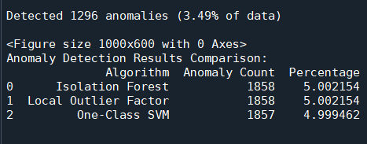
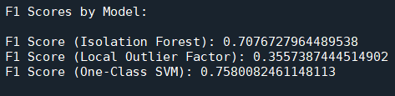
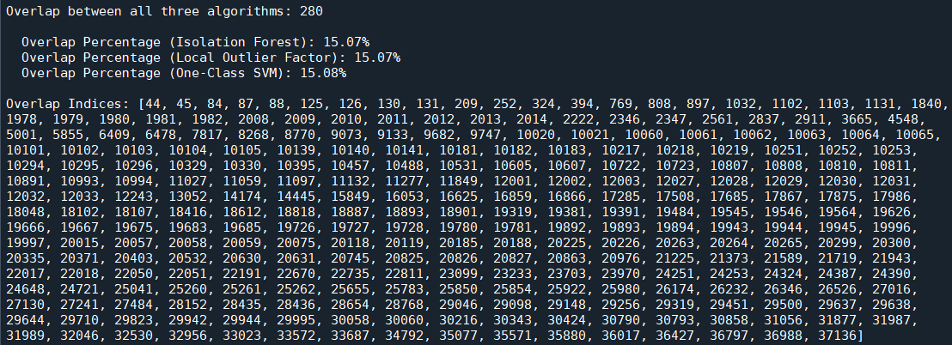
Output 1: This shows the percent of the total data that was detected to be anomalies by the F1 scored-based anomaly detection and each of the three models individually.
Output 2: This shows the F1 score of each of the three models:
- Isolation Forest becomes weighted at 0.3885 (38.85%).
- Local Outlier Factor becomes weighted at 0.1953 (19.53%).
- One-Class SVM becomes weighted at 0.4162 (41.62%).
Output 3: This shows the overlap indices and percentage of overlap for all three models; these anomalies would be automatically included in the F1 score-based anomalies (anomaly score equal to one).

Slide 8
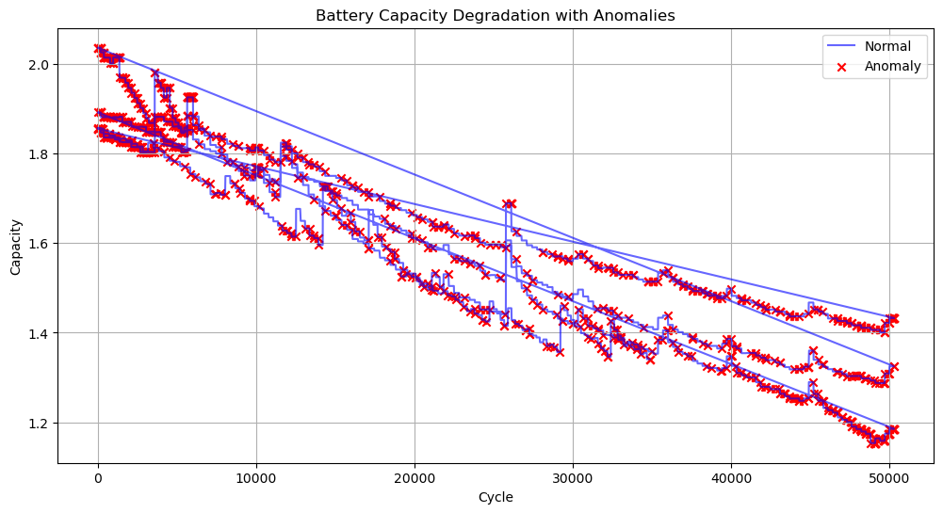
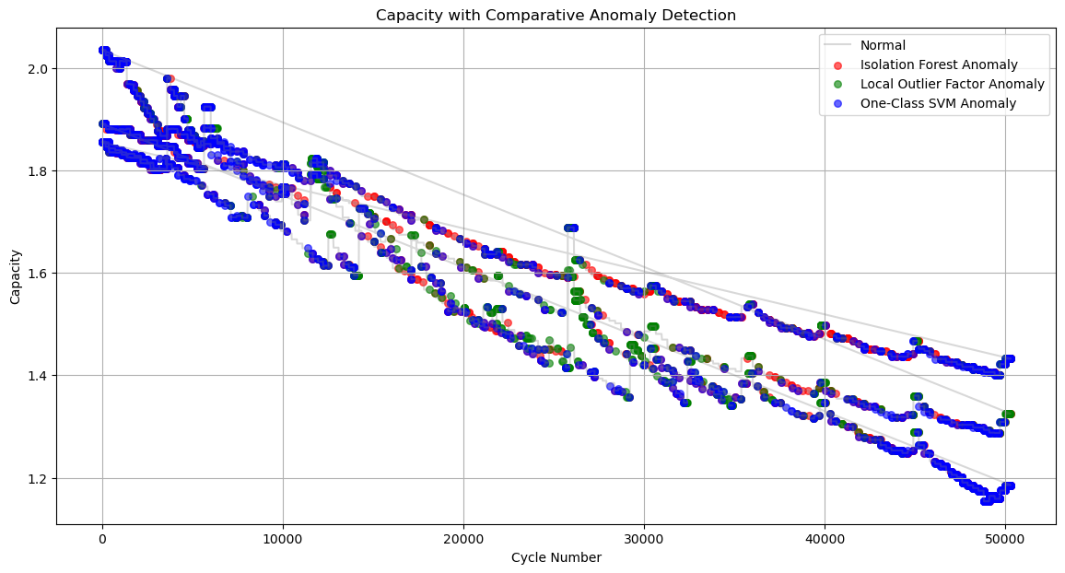
Figure 1A: This shows how all 4 cell capacities decay over the number of cycles with anomalies detected based on F1-score weighted anomalies.
Figure 1B: This shows the capacity degradation plot with anomalies detected by each model.

Slide 9
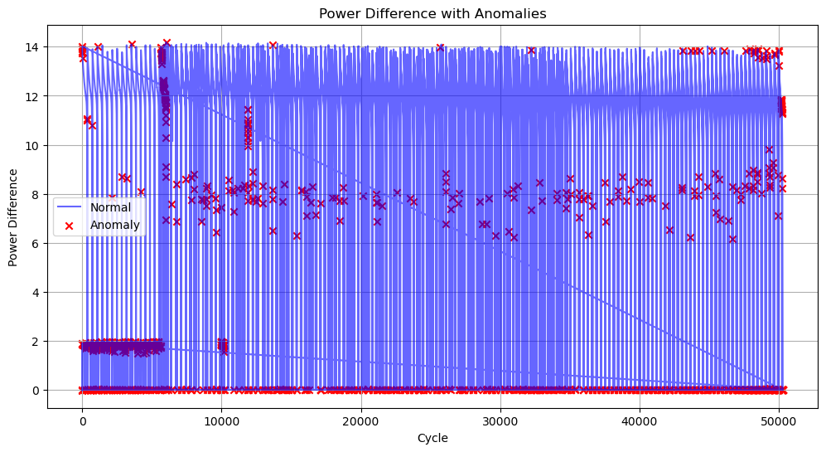
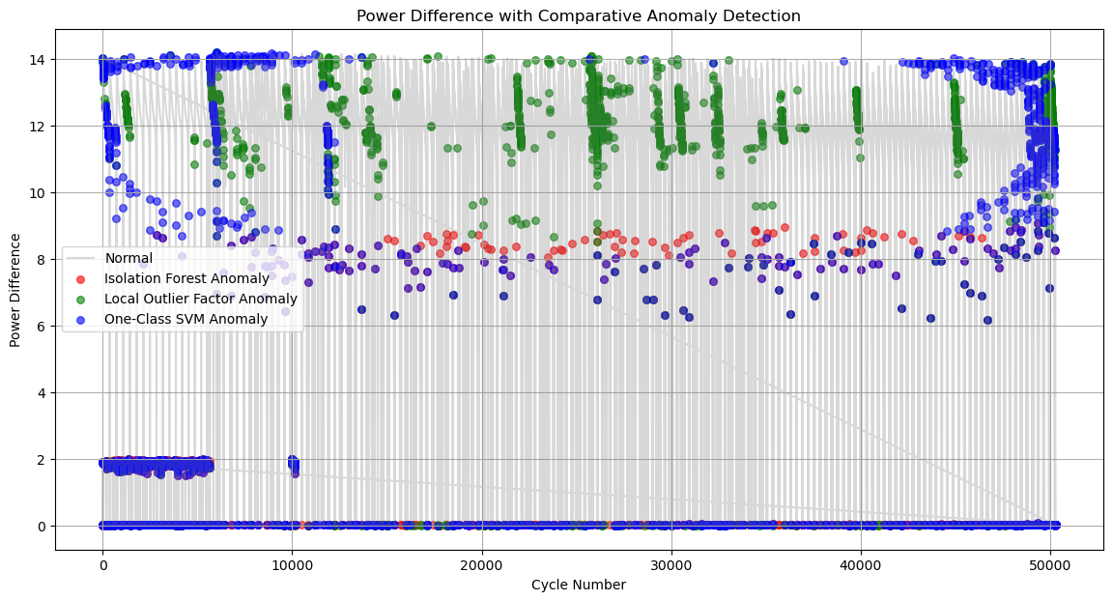
Figure 2A: This shows the power difference of all 4 cells over the number of cycles with anomalies detected based on F1-score weighted anomalies.
Figure 2B: This shows the power difference over cycle anomalies detected by each model.

Slide 10
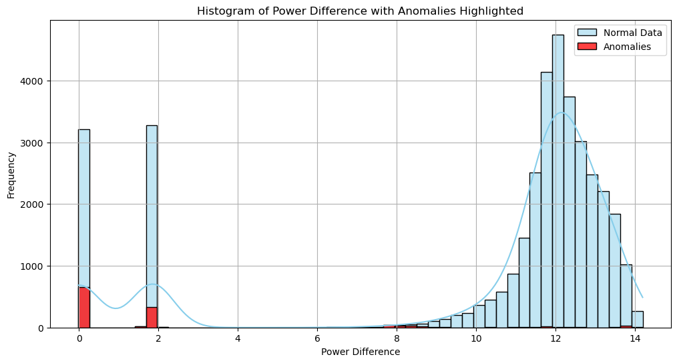
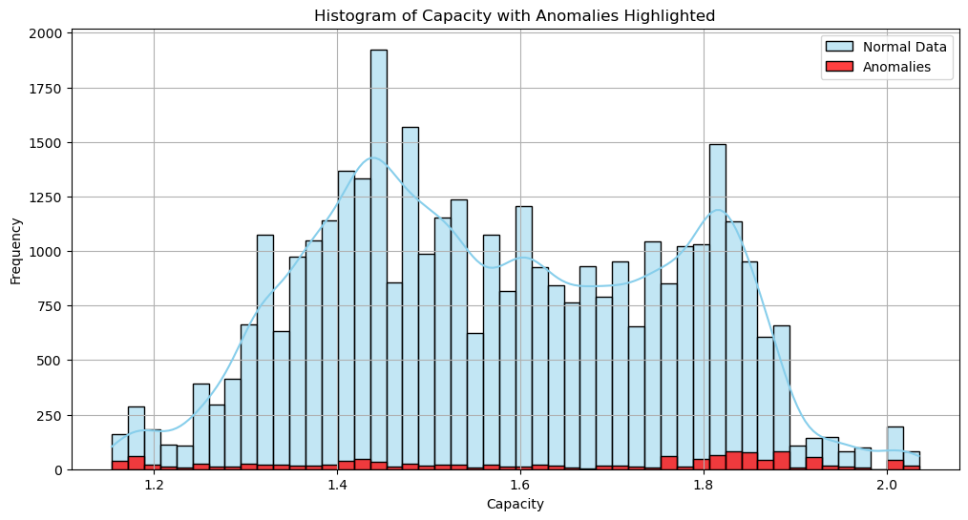
Figure 3: This shows a histogram of the data for power difference with anomalies detected based on F1-score weighted anomalies.
Figure 4: This shows a histogram of the data for capacity with anomalies detected based on F1-score weighted anomalies.

Slide 11
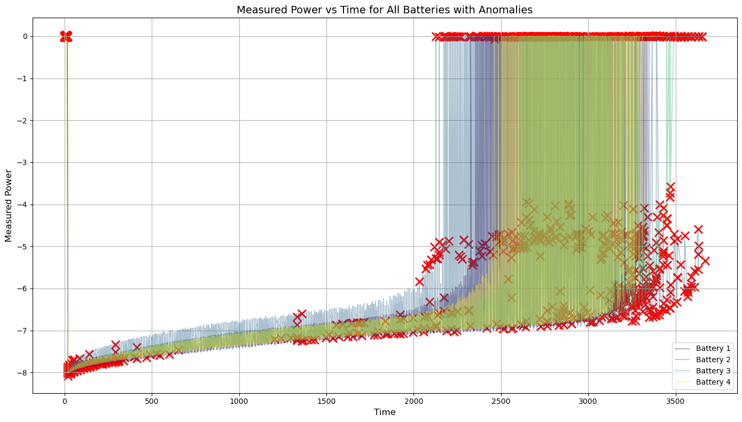
Figure 5: This shows a graph of measured power versus time for each of the four batteries individually with anomalies detected based on F1-score weighted anomalies.

Slide 12
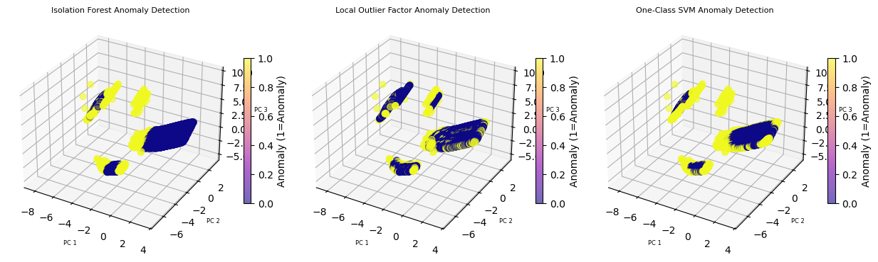
Isolation Forests Local Outlier Factor One-Class SVM
Anomalies Detected Anomalies Detected Anomalies Detected
(BLUE) Undetected Anomalies in IF model
(BLUE) Undetected Anomalies in LOF model
(BLUE) Undetected Anomalies in SVM model
Figures 6A, 6B, and 6C: These are PCA plots for each of the three models used.

Slide 13
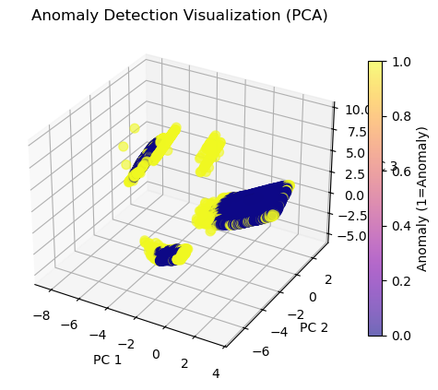
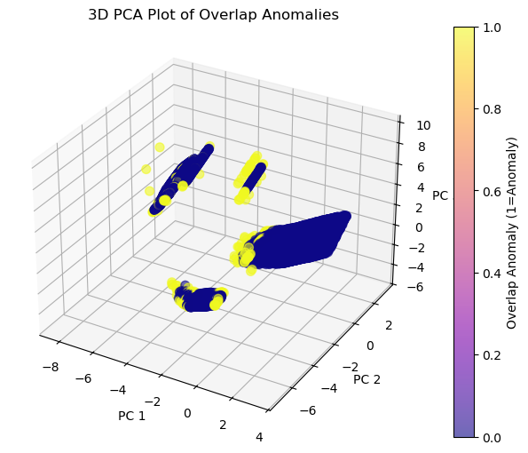
Figures 7 and 8: This shows the PCA plots for F1-score weighted anomalies and overlap anomalies.
F1-Score Weighted Comparison; Highlights model weights
Highlights Anomalies in union with all 3 algorithms; most likely to be "true positives"

Slide 14
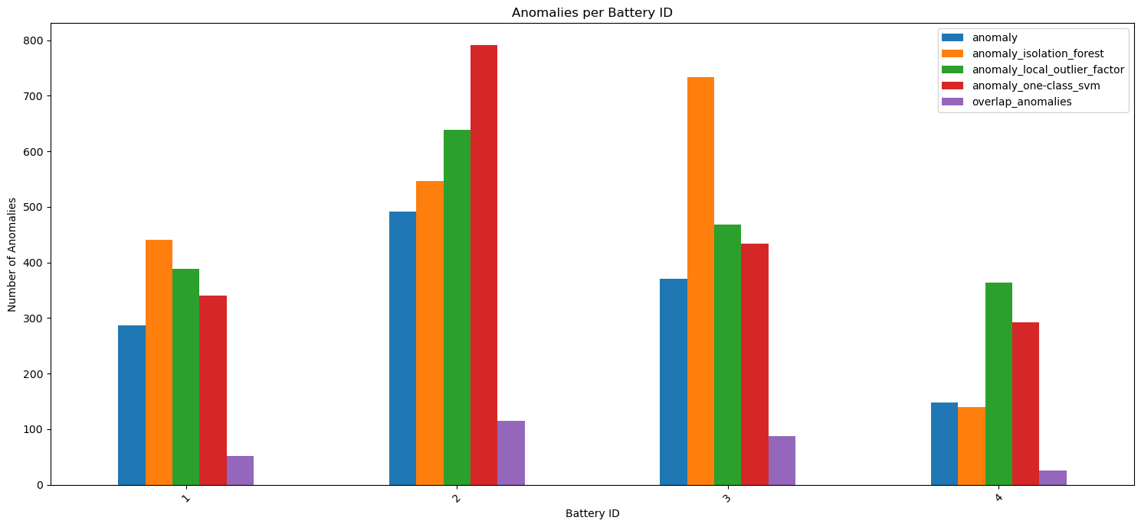
Figure 9: This shows the number of anomalies detected through each of the three models (orange, green, and red), the F1-score weighted anomalies (blue), and the anomalies based on the overlap indices of the three models (purple).

Slide 15
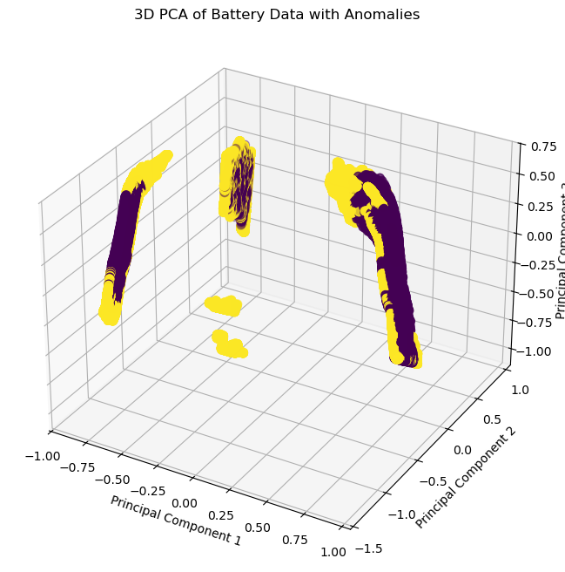
Figure 10: This is the PCA plot for the supervised learning model using F1-score weighted anomalies from the unsupervised model as truth values.
Clear & distinct groupings ==> Minimized error and operation states of the fuel cell.
More Separation in Anomalous Cluster

Slide 16
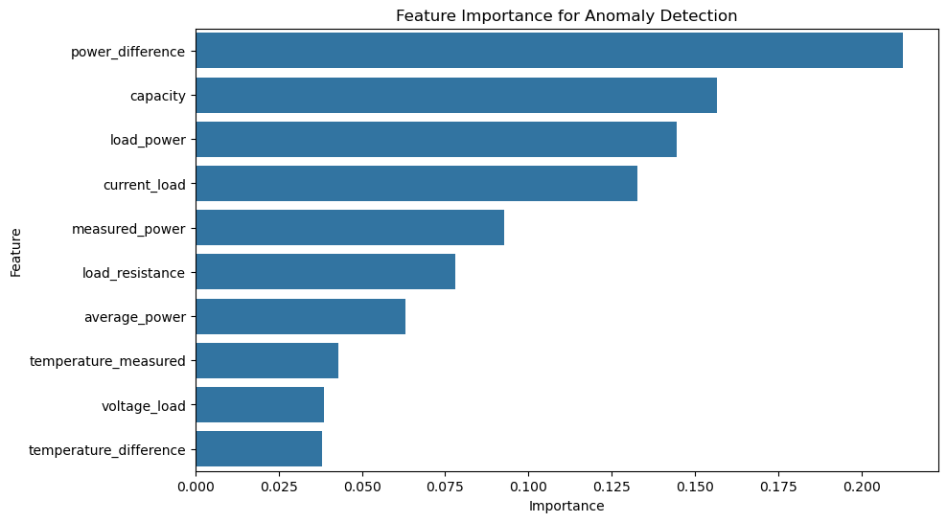
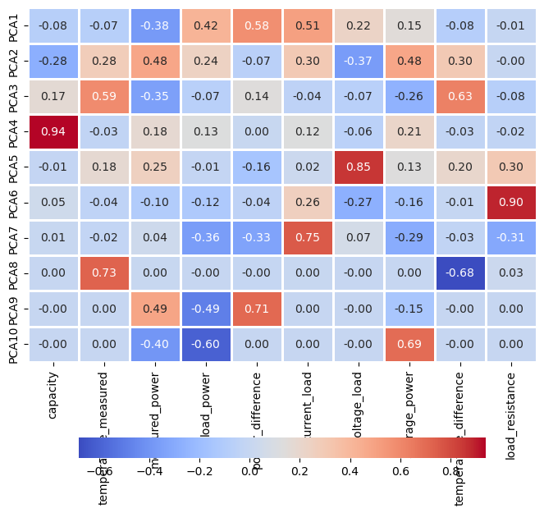
Figure 11: This shows a bar graph of the most important features in anomaly detection for the hydrogen fuel cell data using the supervised learning method.
Figure 12: This shows the heat chart for PCAs 1-10 against the 10 features used for the PCA analysis.

Slide 17
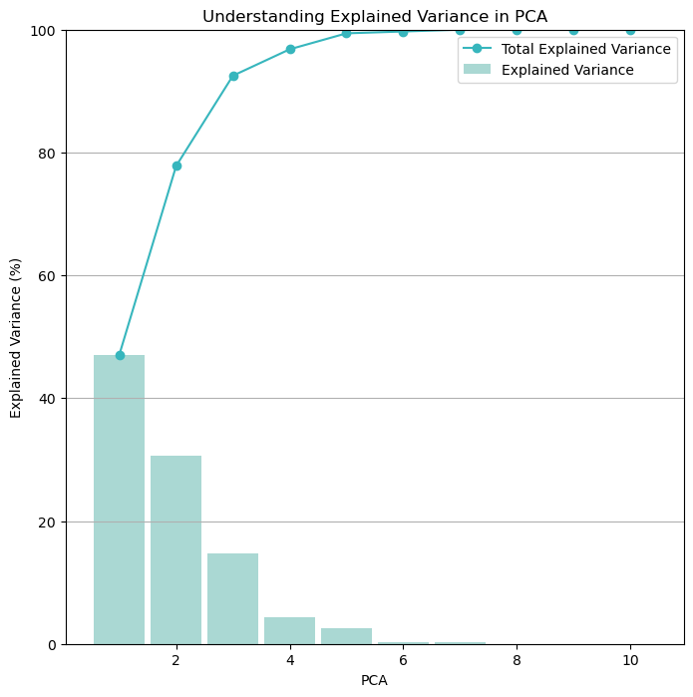
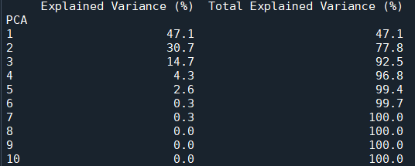
Output 4: This shows the table of the explained variance for each of the principle components in the PCA analysis as well as the total explained variance for the data used in the supervised learning method.
Figure 13: This shows a bar graph of the explained variance of the PCA data used in the supervised learning method.

Slide 18
Model | Training Accuracy (%) | Testing Accuracy (%)
Logistic Regression | 86.219 | 85.907
Support Vector Machine (Linear Classifier) | 86.892 | 86.555
Support Vector Machine (RBF Classifier) | 94.025 | 93.654
Decision Tree (Classifier) | 100.000 | 99.163
Random Forest (Classifier) | 100.000 | 99.365
K-Nearest Neighbors | 97.850 | 97.517
Table 1: The training and testing accuracies for each of the models tested using the F1-score weighted anomalies as truth values for the supervised machine learning method.

Slide 19
Conclusion of Study
Visually demonstrate the separation and overlap of anomalous data points by unsupervised & supervised learning methods to quantify the significance of overlapping anomalies.
F1-score weighting of the respective detection models prioritize high-confidence, shared anomalies for further "expert" diagnostic investigation in H2 Fuel Cell Systems.

Slide 20
Thank You For Your Time. Any Questions?

